Slide 1
Professional Ethics in Engineering
Background (5 hours)
1.0
1.1
1.2
1.3
1.4
Background
History of Engineering practice
Cultural, Political, Societal motivations and limitations Impacts and consequences of technology on society
Education and training of technologists, scientists and engineers
School of Engineering , Pokhara University

Slide 2
1.1 History of Engineering Practice
Engineering: Application of data, information, knowledge and technique for practical beneficial use.
“Beneficial for whom?” and “Are the benefits sustainable?” are relatively modern issues in Professional Engineering Practices.
If a particular engineering project benefits only a few persons in a society, is it justifiable? If an engineering project’s benefit is unsustainable, should the society promote it?
Short History of Engineering Practice

Slide 3
1.1 History of Engineering Practice
Concrete is used for arched bridges, roads and aqueducts in Rome (1200 BC-1 AD)
Gunpowder use improved (1-1000 AD)
Manufacturing and use of silk and glass (1000-1400 AD)
Toilet, telescope, vacuum, and Gas Law (1400 – 1700 AD)
Industrial revolution, steam engine, Society of Engineers (UK), cast iron building (1700-1800 AD)
Mechanical automation, railroad, telegraph (1800-1825 AD)
Reinforced concrete, synthetic plastic material, Oil well, mass production of steel, typewriter (1825-1875 AD)

Slide 4
1.1 History of Engineering Practice
Telephone, light bulb, gasoline engine, automobile (1875-1900 AD)
Short History of Engineering Practice (continued…)
Aeroplane, diesel engine, commercial flight, mass production of automobile (1900 – 1925 AD)
TV, atom bomb, transistor (1925-1950)
Computer, artificial satellite, moon landing, electronic hand held calculator (1950-1975)
Supersonic plane, reusable rocket, artificial heart (1975-1990)
Robot, under-sea train, internet, email, GPS (1990-2000)

Slide 5
1.1 History of Engineering Practice
2000 onwards: Exponential expansion in application of engineering affecting daily life: Continuous connection anytime,
anywhere, mobile phone, electronic surveillance of equipment
and people, automation of virtually everything, instant access to data and information, service industry dominating manufacturing.

Slide 6
1.2 Cultural, Political, Societal motivations & limitations
Cultural practices, customs, rituals, and belief systems can motivate or demotivate development and adoption of science
and technology.
low value of time and punctuality, low value of work, intellectual property right and copy right, research
more value to ritual, predestination, formality, religion, tradition, caste
Political systems can create conducive environment or hurdles in development and use of science and technology.
Authoritarian, despotic, repressive, lack of rule of law, impunity, irregular and selective application of law, lack of freedom of expression and choice frequently changing policies and rules, vague regulations

Slide 7
Social norms and values can encourage or discourage (assign arbitrary limits) people to be professional engineers.
Gender-class-caste roles, defective social norms and values, gap between rich and poor, access to health and education, social security, conflict, rent seeking culture, suspicion of new ideas and technologies
Impacts and consequences of technology on society
The impacts and consequences of technology on society are multifaceted (consequences are positive or negative, depending on use or abuse, or ability to prevent abuse)
Impact on social values and family structure

Slide 8
Impact on cultural norms
Impact on transportation of goods and services
Impact on communication and information generation
Impact on production means and price of goods
1.3 Impacts and Consequences of Technology on Socioeconomic parameters (positive): a) Agriculture
Impact on | Impact
Food Production | Mechanized, increasing, Green Revolution, GMF, vertical hydroponic

Slide 9
Food Processing | Food processing getting complex, requiring industrial management
Food Preservation | Food security increasing, for most, better food preservation
Commercializat ion | From subsistence to cash crop, patented seeds and food processing techniques
Food Variety | Increasing, year round availability, no more seasonal
Fertilizer/Pesticide | From organic to chemical, pesticide use increasing
Water use | Increasing due to cash crops & agricultural intensification; reduced by micro-irrigation

Slide 10


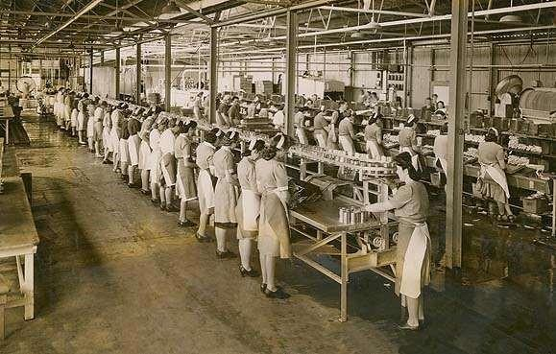
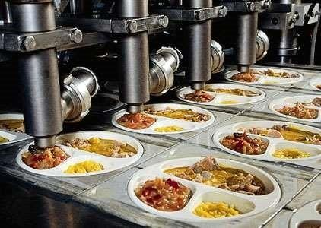
Hydroponic agriculture
From traditional to modern food processing

Slide 11
1.3 b Impact on Communication
Impact on Impact
Information generation and Increasing access to information
dissemination
Mass communication: Newspaper, Magazines, FM Radio, HAM radio, TV, instant/breaking news
Enhanced public awareness, timely information to people
Internet and Social Media
Increased access to information, social media influencing design of communication techniques

Slide 12
Impact on Information Generation, Storage and Dissemination
Telephone, mobile phone | Increased and easier access to telephone
Virtual Meeting, virtual reality, tele-medicine | Less need of physical presence in meeting, distance medicine services and remote controlled operation possible
1.3 d
Impact on | Impact
Information access | Increasing access to information through multiple mediums
Storage, virtual storage | Tape, Floppy disk, CD, DVD, External hard disk, Dropbox, Cloud storage, mailbox
Generation | Information generation growing exponentially, automatic data logging, GIS, GPS, Satellite Images, Remote sensing

Slide 13
Impact on Dispute/Conflict Resolution
Dissemination | e-paper, interactive TV, internet, social media
1.3 e
Impact on | Impact
Warfare | Increased use of gun power, rockets, missiles, drones, improvised explosive devices, chemical-biological
WMD | A-bomb, H-bomb, nuclear bomb made but not yet used (except two in WW II), Star War, MAD policy
Evidence | Evidence recorded in electronic media

Slide 14
Impact on | Impact
Family | Family relation more complex, IV-fertilization, test-tube baby, cloning, surrogacy, same sex marriage, family size reducing, microfamily getting possible, life span increasing, change in status of female and disabled
Tradition/ Culture | Traditions-values challenged and altered or replaced, heritage preservation better
Recreation | Traditional dances/music/drama/games giving ways to movies, video games, theme parks, pay per view
Social Norms and Values | Social norms and values increasingly challenged and altered or replaced, social class structure disintegrating, new economic class emerging

Slide 15
Impacts on Family Structure, Culture and Livelihood
Language | International language use increasing, language getting standardized, brail script & sign language use increasing
Livelihood and living standard | Livelihood diversification & specialization increasing, Living standard & HDI increasing, poverty decreasing, employment opportunity increasing, price decreasing
1.3 f

Slide 16
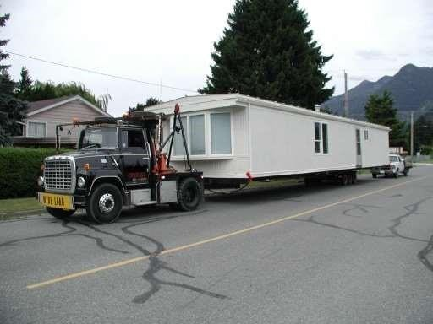
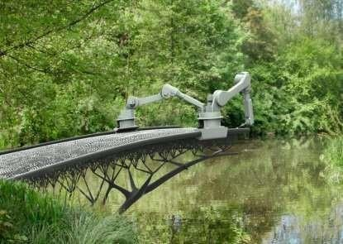
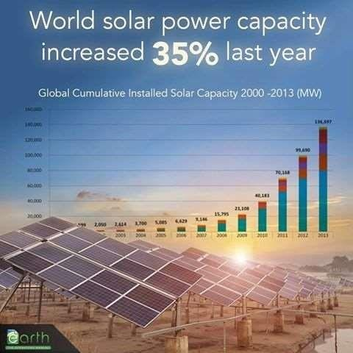
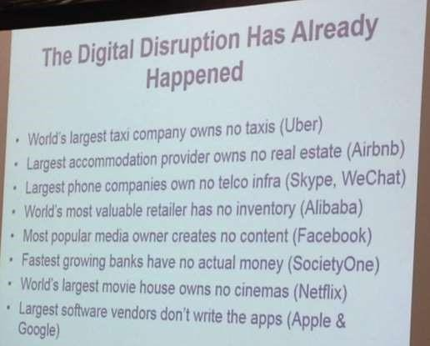

Slide 17
Electrical Vehicle
First electrical vehicle: 1937 Robert Davidson
In 1912: 38% of vehicles in US were electrical
Volvo: No gasoline based vehicle (GBV) production from
2019 (only two years from now)
France: Ban on use of GBV from 2040
Germany: Ban on trade of GBV 2030
Netherlands, Norway: Ban on trade of GBV from 2025
India expected to follow suit.

Slide 18
Computer and Computer Crimes
Computer:
Modeling, simulation (visualization of potential impacts and solution before the event occurs and solutions implemented), design, solution techniques (FDM, FEM), Management Information System, Spatial planning using GIS, computer crimes, intrusion on personal privacy, data mining, data theft,
Effects: information generating, storing and dissemination
Design of materials using simulation
Electronic equipment
Electronic Transaction Act 2063 (2006) has listed the following acts under the Computer Crime
Theft, damage or alteration of computer source code
Unauthorized access to materials on computer
Destruction and computer and information system
Publication of illegal materials on electronic form

Slide 19
Violation of confidentiality
Posting of false information
Submitting or showing forged license or certificate
Non-submission of the document or other materials •
Computer fraud
1.4 Education and training of technologists, scientists and engineers
Continuous education and training (E&T) is a regular process for the
technologists, scientists and engineers (TSE)
New concept, knowledge, technology, hardware and software, materials, equipment, tools, gadgets, keep coming in the market. New policies, acts/laws, rules and standards are periodically adopted. The TSE need to keep up with the latest developments to prevent themselves from being out of date.
o Information & Technology Policy 2000; Science & Technology Policy, 2005 o The Electronic Transactions Act 2006 o Electronic Transactions Rule

Slide 20
2007 o Nepal Electronic Cheque Clearing Rule Book, 2011 (ECC Rule) o e-
governance, e-bidding, e-procurement, e-banking, e-sewa, o High Level Commission for Information Technology
Nepal Administrative Staff College caters to the continuous E&T needs of administrative staff; no similar institute for TSEs in Nepal.
Continuing Education Division/IoE partially caters to the needs of TSEs
Currently a myriad of different organizations are filling the gap of lack of formal system of E&T for TSEs in Nepal.

Slide 21
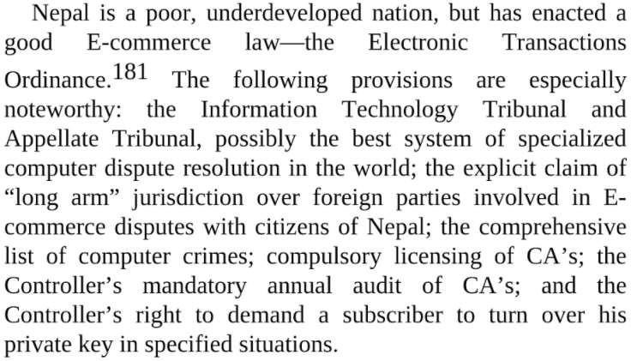

Slide 22
Potential Questions
List the type of cultural, political and societal practices which motivate development of science and technology in a society.
List the type of cultural, political and societal practices which limit development of science and technology in a society.
What is the impact of development of ICT in social values?
What is the impact of computers in mechanized production, and how has it impacted society?

Slide 23
What are the different forms of computer crimes, and how has computer crime impacted society?
What should be the modality of the education and training of the technologists, scientists and engineers?
What specific type of training should the electronics engineers and/or electrical engineers be provided?

Slide 24
Professional Ethics in Engineering
Profession and Ethics (3 hours)
Profession and Ethics
Definition and Characteristics
Codes of ethics and guidelines for professional engineering practice
Relationship of engineering profession to other professions (e.g. fellow engineers, clients and contractors)
Moral dilemma on ethical decision making
Negligence and Liabilities

Slide 25
2.1 Definition and Characteristics
Profession: An occupation carried out with a systematic knowledge acquired through specialized training or education and experience and practicing the same.
Professional: A person practicing a profession in area of expertise.
Professionalism: The content of profession with moral and ethical behaviours.
Acts of a professional are evaluated by the public.
Professionals follow their code of conduct, and standards and norms.
Professional have their own culture

Slide 26
2.1 Definition and Characteristics
– Through regular interactions, communications and experiences in same field
Ethics: generally concerned with rules or guidelines associated with a profession.
Ethics is normally clear; ethical and unethical behaviours are easier to distinguish, hence no ethical dilemma, as opposed to moral dilemma.

Slide 27
Ethical acts are legal and moral; but a particular moral act is not necessarily ethical/professional.

Slide 28
2.2 Codes of ethics and guidelines for professional engineering practice
Different professional engineering societies have issued Code of Ethics for their
members. Examples: ABET, IEEE, ASME, NEC, NEA, SCAEF, FCAN, CAN, …
Accreditation Board of Engineering and Technology (ABET) Code of Ethics for Engineers:
Engineers shall hold paramount the safety, health, and welfare of the public in the performance of their professional duties.
Engineers shall perform services only in the areas of their competence.
Engineers shall issue public statements only in an objective and truthful manner.
Engineers shall act in professional matters for each employer or client as faithful agents or trustees, and shall avoid conflicts of interest.

Slide 29
5. Engineers shall build their professional reputation on the merit of their services and shall not compete unfairly with others.
Engineers shall act in such a manner as to uphold and enhance the honor, integrity, and dignity of the profession.
Engineers shall continue their professional development throughout their
careers and shall provide opportunities for the professional development of those engineers under their supervision.
IEEE Code of Ethics:
to accept responsibility in making decisions consistent with the safety, health, and welfare of the public, and to disclose promptly factors that might endanger the public or the environment;
to avoid real or perceived conflicts of interest whenever possible, and to disclose them to affected parties when they do exist;
to be honest and realistic in stating claims or estimates based on available data;
to reject bribery in all its forms;

Slide 30
5. to improve the understanding of technology; its appropriate application, and potential consequences;
to maintain and improve our technical competence and to undertake
technological tasks for others only if qualified by training or experience, or after full disclosure of pertinent limitations;
to seek, accept, and offer honest criticism of technical work, to acknowledge and correct errors, and to credit properly the contributions of others;
to treat fairly all persons and to not engage in acts of discrimination based on race, religion, gender, disability, age, national origin, sexual orientation, gender identity, or gender expression;
to avoid injuring others, their property, reputation, or employment by false or malicious action;
to assist colleagues and co-workers in their professional development and to support them in following this code of ethics. http://www.ieee.org/about/corporate/governance/p7-8.html

Slide 31
NEC code of ethics
Discipline and Honesty: The Engineering sevice/profession must be conducted in a disciplined manner with honesty, not contravening professional dignity and well-being.
Politeness and Confidentiality: Engineering services for customers should be sealt with in a polite manner and professional information should remain confidential except with written or verbal consent of the customers concerned. This, however, is not deemed to be a restriction to provide such information to the concerned authority as per the existing laws.
Non-discrimination: No discrimination should be made against customers on the grounds of religion, sex, caste or any other things while applying professional knowledge and skills.

Slide 32
NEC code of ethics
4. Professional Work: Individuals should only do professional work in their field or provide recommendation or suggestions only within the area of theri study or obtained knowledge or skills. With regards to the works not falling within the subject of one's profession , such as works should be recommended to be done by an experts of the subject matter.
5. Deeds which may cause harm to the engineering profession: With the exception of salary, allowance, and benefits to be received for services provided, one shall not obtain improper financial gain of any kind of conduct improper activities of any kinds, which would impair the engineering profession.

Slide 33
Personal responsibility: All individuals will be personally responsible for all works performed in connection with his/her engineering profession.
State name ,designation and registration number: While signing the documents or descriptions such as the design , map , specification and estimates etc ralating to the Engineering profession , the details should include, the name , designation and NEC registration No. and should be stated in a clear and comprehensive manner.
No publicity or advertisement to be made which cause unnecessary effects: In connection with the professional activities to be carried out, no publicity or advertisement shall be made so as to cause unnecessary effects upon the customers.

Slide 34
Relationship with fellow engineers:
2.3 Relationship of engineering profession to other professions (e.g. fellow engineers, clients and contractors)
Professional relationship with all the engineers, regardless of their status, and even if the fellow engineer is a close relative
“Engineers shall not attempt to injure, maliciously or falsely, directly or indirectly, the professional reputations, prospects, practice or employment of other engineers, nor indiscriminately criticize the work of other engineers”
Criticize cautiously and objectively with respect to the person’s
professional status
Have professional relationship
– Encourage fellow engineers to follow Code of Ethics

Slide 35
Guide, train and orient freshly graduate engineers
Create platform for information and knowledge sharing
Support fellow engineers in professional development
Engineer’s relationship with Client:
Strict professional relationship, even if the client is closely familiar (relative, friend)
No discrimination among client based on culture, race, religion, sex, …
Work in the best interest of the client with loyalty with legal limit
Deliver in time, with quality
Not expect extra favour for works performed as per an agreement
“An engineer shall not accept financial or other compensation from more than one party for services rendered on one project unless the details are fully disclosed and agreed by all parties.”

Slide 36
Supervise work and prevent misuse/abuse of client’s property/trust
Assist in decision making by providing options
Warn potential risks of decisions
Going beyond ToR, when professionally required
Keep information confident, unless required by law
Full disclosure of potential conflict of interest, if any
Not take a client for granted: remembrance of bad experience lingers much longer than a good experience
Engineer’s relationship with Contractor:
Strict professional relationship, even if the contractor is closely familiar (relative, friend)
Provide due respect to the contractor

Slide 37
No discrimination among contractors based on belief, race, religion,
culture, sex, sexual orientation, …
Provide all the detailed drawings, quantity and quality (including specification) of works (goods and services) to the contractor in time
Check and approve running bills in time, as per specification
Not expect or accept (directly or indirectly) extra favour of significant value, for works performed as per an agreement
Supervise work and prevent use of sub-standard methods and materials being used
Participate in co-decision making by providing options when necessary
Assist the contractor when variations are technically needed
Warn potential risks of decisions/actions
Going beyond ToR, when professionally required

Slide 38
2.4 Moral dilemma on ethical decision
making
Ethical decision, which is legal and follows all the prevailing rules, regulations, and standards, and is beneficial to the client, may result in (a)
environmental damage beyond the limit what the engineer considers to be moral, (b) reduced public
safety, (c) loss to helpless, voiceless, marginalized
stakeholders. Such a situation creates a moral dilemma to an engineer.

Slide 39
2.5 | Negligence and Liabilities
Negligence in duty (dereliction of duty) results in liabilities to stakeholder whose life, health or property is damaged. Conditions for establishment of professional negligence:
Duty: Unless there is a contractual duty to perform a work there is no negligence in the performance of the work.

Slide 40
Breach: Unless there is a breach of the terms and conditions of an agreement, professional negligence cannot be proved.
Damages: Unless there is a specific damage to the claimant, professional negligence cannot be established.
Proximate cause: There should be direct (one-to-one) relation between the specific action of a professional and the damage resulted by the action to the claimant.
2.5 Liabilities of engineers in project design,
construction and implementation
Three sources of liability:

Slide 41
a) Liabilities due to contract: liable to fulfill all terms of contract; if there is no contract, legally, there is no liability under this category. An engineer is liable for loss of damage due to breach of contract clauses. Contract law imposes liability on a party for promises that the first has made to another party; liability related to loss of a single person’s life/property.
Liabilities due to criminal law: liable to follow all prevailing laws of nation, breach of law related to design, construction and implementation of design can result in criminal case, whether there is damage or not. Criminal law imposes liability on a party due to illegal/ criminal acts; defendant has a liability to the government/state.
Liabilities due to tort: liable to prevent customers/users of products and services from loss or damage; even if there is no specific contract and no laws have been breached, an engineers can be held liable for loss or damage to the customer due to the use of services and products designed, constructed, or implemented by the engineer. Pre-information or pre-warning or disclaimer

Slide 42
Vicarious and Partnership Liability
can prevent an engineer from liability due to tort. Tort provision is a legal
mechanism for compensating individuals injured by others, whether deliberate or not; directed toward the compensation of individuals, rather than the public.
Two types of liability:
Vicarious Liability: A company or a contractor/sub-contractor is liable for the acts of its own and its employees. Three tests are used to ascertain the degree of vicarious liability.
– Control test: degree of liability depends on level of control a company has on its staff or contractor; the more control a company has over a person (employee) the more liable the company is.

Slide 43
Business integration test: degree of liability depends on level of business integration; the more the work of a person is integrated into the work of a company, the more liable the company is for the acts of the person, even if the person is not a direct employee of the company.
Multiple test: Control test, business integration test, and other related factors are taken into consideration to determine the degree of liability.
Partnership Liability: Liability of the partners in tort: The partners of a company are liable for the acts of one (or more) of its other partners.
2.5 Liabilities of engineers in project design,
construction and implementation
Liabilities of an engineer in project design

Slide 44
Fitness for purpose: The design of a project (overall and component-wise) should be proper to serve the purpose of the project.
Negligent misstatement: The designers and professionals are expected not to make any negligent or unsubstantiated misstatements.
Statutes, bylaws and building regulations/codes: It is the duty of the designers and professionals to make themselves fully aware of the statutes, bylaws and codes related to their professional practice.
Examination of site above and below the ground: Before finalizing a design, a designer should know the conditions of the site above and below the ground.
Public and private rights: The design of a project should not contradict with the public and private rights of the client and others who may be affected by the design implementation.
Plans, drawings and specifications: The design should include detailed plan, drawing, and specification of each component of the project and equipment
Materials (quantity, quality and availability): The details of the quantity and quality of materials to be used in a project should be specifically mentioned. The availability of the materials should be kept in mind while selecting the material types.
Novel, risky design and employers’ interference in design: A designer may choose to use novel and risky design, and may decide to incorporate employer/client’s idea in the design. However, the designer is ultimately responsible for the safety & fitness for purpose of the design implementation.

Slide 45
Revision of design during construction: Even if the design is revised during construction, the designer is ultimately responsible for the safety & fitness for purpose of the design implementation.
Liabilities of engineers in project construction and
implementation
Completion of project in time, within budget
With quality: material, workmanship, method of construction
Consistency: in quality, form
Safety and welfare of project workers, people living in and around project area, and people travelling through or visiting the project area
Follow applicable laws, rules, regulations, guidelines, conventions, codes and bylaws

Slide 46
Potential Questions
What are the essential elements of a professional person?
What are the characteristics of an ethical decision making?
Discuss Nepal Engineering Council’s code of ethics.
What should be the nature of the relationship between an engineer and a client?
What are the conditions necessary to prove professional negligence in engineering practice?
Discuss, with examples, three basic sources of liability of an engineer.
Discuss the objectives of tort liability.
Discuss the vicarious liability and partnership liability, with examples from electronics and/or electrical engineering applications.
Discuss, with an example, a case of moral dilemma when making ethical decisions.

Slide 47
Discuss the liabilities of an engineer in project design and project implementation.
Professional Ethics in Engineering
Professional Practices in Nepal (4 hours)
3.0
3.1
3.2
3.3
Professional Practices in Nepal
General job description of an engineer in public and private sector Public and Private sector practices
Roles of Professional Associations

Slide 48
3.0 Professional Practices (in engineering) in Nepal
Professional Practices of engineering in Nepal are guided
formally by the laws/acts, guidelines, directives, cabinet decisions, standards and codes,
Guidelines, and code of Ethics of professional bodies like Nepal Engineers’ Association, SCAEF, FCAN, CAN, IEEE

Slide 49
informally by the practices in specific institutions
3.1 General job description of an engineer in public and private sector
General duties of an engineer are mainly:
Design and estimate of specific project, infrastructure etc.
Preparation of technical specification, tender documents, contract document, agreement paper
Evaluate and supervise the project assigned
Allocation of resources
Work as a member of investigation committee

Slide 50
Prepare Annual Plan or Project specific plan of activities
Provide suggestion and recommendation in area of expertise

Slide 51
3.1 General job description of an engineer in public sector (Gazetted Third Class)
Perform preliminary and detail survey, design and estimate
Execute and assign for execution of project works
Conduct various programs for increasing
people’s capacity

Slide 52
3.1 General job description of an engineer
Prepare Progress Report , Feasibility Report
, Final Report, Monitoring and Evaluation report etc.
in public sector (Gazetted Third Class)
To execute other jobs planned specifically for engineers as the nature and case may be
To monitor and evaluate on going projects
To facilitate donor agencies is involved

Slide 53
3.1 General job description of an engineer
To monitor and coordinate the operation and maintenance of facilities
To execute and perform works and jobs assigned by immediate superiors
in public sector (Gazetted Second Class)
Planning, programming and execution of works

Slide 54
3.1 General job description of an engineer
Research on technology, cases, various skills for upgrading
Administrative activities
Financial administrative activities in private
sector
Coordinate works between stakeholders, clients, consulting and contractors
Layout works, to survey and to estimate
Supervise, monitor, and control works

Slide 55
3.1 General job description of an engineer
Control quality, to assess and report to concerning authorities
Prepare bills as a quantity surveyor
Plan project and report progress
Prepare technical report and prepare claims if any
Conduct necessary training regarding site work and office organizations system to new staffs
Overall management of construction project etc.

Slide 56
Typical work assignments
Electrical engineers typically do the following:
Design new ways to use electrical power to develop or improve products
Perform detailed calculations to develop manufacturing, construction, and installation standards and specifications
Direct the manufacture, installation, and testing of electrical equipment to ensure that products meet specifications and codes
Investigate complaints from customers or the public, evaluate problems, and recommend solutions
Work with project managers on production efforts to ensure that projects are completed satisfactorily, on time, and within budget
Electronics engineers typically do the following:
Design electronic components, software, products, or systems for commercial, industrial, medical, military, or scientific applications
Analyze customer needs and determine the requirements, capacity, and cost for developing an electrical system plan
Develop maintenance and testing procedures for electronic components and equipment

Slide 57
Evaluate systems and recommend design modifications or equipment repair
Inspect electronic equipment, instruments, and systems to make sure that they meet safety standards and applicable regulations
Plan and develop applications and modifications for electronic properties used in parts and systems in order to improve technical performance https://collegegrad.com/careers/electrical-and-electronics-engineers
3.2 Public and Private sector practices
The scope of work carried out by the engineers in the public and private sector covers many areas. The scope of work of each public and private organization is listed in their website

Slide 58
In general, the public organization, or an organization which receives public fund, is
bounded by Public Procurement Act/Rule.
3.2 Private sector practices
In the open market system, there are thousands of private organisations and firms working in engineering sectors
Entrepreneurs have used engineers to produce in large quantity in economic investments,
Private sector working more efficiently under strict supervision and motivations
More than 50 private engineering colleges affiliated to 7 universities - governmental and nongovernmental.

Slide 59
Numerous consultancies, construction companies and firms
Many computer institutes, training institutes, e-business organisations, hospitals, research centers have employed engineers
Sample List of Public Organizations (ministries) where engineers are involved/employed
Finance
Home Affairs
Foreign Affairs
General Administration
Law and Justice
Land-reform and Land Management
Women, Children and Social Welfare
Education and Sports
Defence
Health
Labor and Transport
14. Population and Environment

Slide 60
15. Culture, Tourism and Civil Aviation
Science and Technology
Information and communication
Federal Affairs and Local Development
Irrigation
Energy
Physical Infrastructure and Transports
Forests and Soil Conservation
Industry, Commerce and Supply
Agriculture and Cooperative
Note: The name of the ministries keep changing. Many more engineers are employed in the departments under the ministries.

Slide 61
Sample List of Public/Semi-Public Organizations where engineers are
involved/employed
Nepal Telecommunication Authority
Nepal Airlines Corporation
Diary Development Corporation
Nepal Industrial Development Corporation
Nepal Electricity Authority
Nepal Rastra Bank
Agricultural Development Bank
Rastriya Banijya Bank
TU/PU/PU/MWU/FWU/KU
University Grants Commission
Hetauda Cement Factory
Udayapur Cement Factory
Nepal Telecom
CAAN
Diary Development Corporation
Investment Board Nepal
Salt Trading Corporation

Slide 62
Industrial Estates (Balaju, Patan,
Pokhara, Hetauda, …)
Central Bureau of Statistics
Nepal Bureau of Standards and Metrology

Slide 63
3.3 Roles of Professional Associations
Regulate professional practices through enactment of rules and reward and punishment system
Develop norms, standards, and codes of professional practices
Monitor practices and performance
Orient new professional members
Enhance professionalism through professional development programs
Provide platform for knowledge sharing and mutual learning
Provide suggestions for development and update of policies/ acts/ laws/ rules/ regulations/ codes

Slide 64
Professional Associations Regulate Profession
One of the fundamental roles of professional associations is to regulate the professional practices of the persons or institutes engaged in a particular profession. E.g., the FCAN regulates the ways contractors, act when performing duties related to their profession, through:
developing guidelines & procedures to be followed by its members,
developing minimum standards of profession,
developing and issuing codes of conduct for FCAN members,
developing and approving written/unwritten rules of the profession,
preparing standard procedure/formats of submitting bids,
monitoring and evaluating compliance of the rules, and
taking actions against breakers of the rules and/or code of conduct.

Slide 65
NEC and NEA regulate engineering profession by developing policies, plans/programs for the smooth functioning of engineering profession and execute them. The NEC regulates higher engineering education in Nepal through evaluation, recognition and monitoring of academic institutes providing formal engineering education.
3.3.1 Roles of professional organizations in induction
of new entrants into the profession
Another major role of the professional associations is to guide new entrants into the profession by
providing orientation and training,
guiding on the conventions of the profession,
providing information on the dos and don’ts of the
profession,

Slide 66
potential pitfalls when the Code of Conduct are not followed,
linking the new comers with established members of the profession.
Guiding on general job description and employers’
expectation from new recruits
Training new entrants for job seekers, proposal writing, bidding, project terms and conditions negotiation, etc.

Slide 67
3.3.2 Upgrading and maintaining the professional and technical competence of members of professional association
Professional societies take various steps for upgrading and maintaining the professional and technical competence of its members by
Organizing regular professional development courses and continuing education programs, like running Engineering Staff College
Organizing skill development oriented training programs
Organizing regular talk programs to share experiences and lessons learned from different projects
Providing platform for its members to expose their works by organizing national and international seminars/workshops on regular basis
Publishing technical journals and news bulletin
Organizing exposure field visits to different projects
Providing exposure to national and international experiences by organizing national and international visits to its members

Slide 68
Proactively working with academic institutes on development and update of university curriculums
Proactively working with research institutes for involving its members in research and development activities
Proactively working with service providing organizations (consulting companies,
contractors, material suppliers, software developers, equipment operators) to establish link of its members with established organizations.
3.3.2 Upgrading and maintaining the professional and technical competence of members of professional association
Some of the ways in which the professional associations in Nepal have been playing this role in Nepal are:
Providing Continuing Education Programs (NEA, SCAEF, FCAN, CAN)
Engineering Staff College (proposed by NEA, not yet fulfilled)
Provision of Professional Engineer (NEC)

Slide 69
Provision of periodic test as part of NEC registration renewal (proposed)
Professional Development as part of evaluation of engineering colleges (NEA)
Organizing professional meeting/seminar/conferences/conclave: (NEA, SCAEF, FCAN, CAN…)
Organizing trainings, weekly lecture series (NEA);
http://www.neanepal.org.np/showmodule.php?what=weeklytalk&under=home
Organizing workshop on specific issues related to engineering education in Nepal (NEC, AECON, OPEN, TUTA)
Some examples: Rapid Assessment Training after April 25, 2015 Gorkha Earthquake; recommendations after Jure Landslide

Slide 70
3.3.3 Providing technical expertise to public authorities in developing policies, acts, standards, project implementation procedures and international agreements and negotiations
The legislators and other governmental organizations frequently seek technical expertise from professional associations in the
development, drafting and amendments to the existing acts, rules, regulations, policies, guidelines, bylaws, provisions, plans and
programs.
NEC, NEA, SCAEF, FCAN, CAN and other professional organizations provide technical expertise to different government organizations, including legislators, as and when requested. When these professional associations do not have in-house expertise, they

Slide 71
coordinate with individual (or institutional) members to provide such services.
NEA and DPNet independently conducted study of Jure Landslide (Sunkoshi) in 2014 and submitted expert advice to deal with the disaster.
(https://drive.google.com/a/nec.edu.np/file/d/0B19Ck0L5dMSrUklZUDN2dk5lZUx6aEtCYnpmenp2TjFId2kw/edit)
3.3.4 Ensuring occupational health, safety and general welfare of the public
The professional engineering associations are expected to play the role of monitors of quality of works of its members, including the matter of safety and general welfare of the public.

Slide 72
When a particular member is found to violate the codes of conduct, compromise on quality of works, and neglect public safety and public welfare, the concerned professional engineering association can warn them, and reprimand/cancel their membership.
NEC is planning to introduce a system of Accountability in Engineering Professional services.
The standard design manuals, design procedures, building codes, including professional judgments will be evaluated as a part of safety and general welfare of public in engineering works.
NEC/NEC/ SCAEF/FCAN etc. can monitor provision of occupational health, safety and general welfare of workers and general public in specific projects.
3.3.5 Role of professional societies in environment protection

Slide 73
Raise awareness among society members, public decision makers, and legislators on environment & sustainable development issues; work with universities in developing environment protection courses
Circulate environment protection related acts, rules and regulations to society members
Study and publish results of impacts (short term and long term) of development works on environment
Develop manuals and guidelines on design, operation and maintenance of development projects by considering environment protection
Conduct training courses on environmental law compliance

Slide 74
Conduct advocacy programs for environment sensitive development methods
Monitor specific development projects from environment protection aspect and suggest improvements, if needed, in carrying out project works with environment compliance
Award organizations with excellent environment protection records.

Slide 75
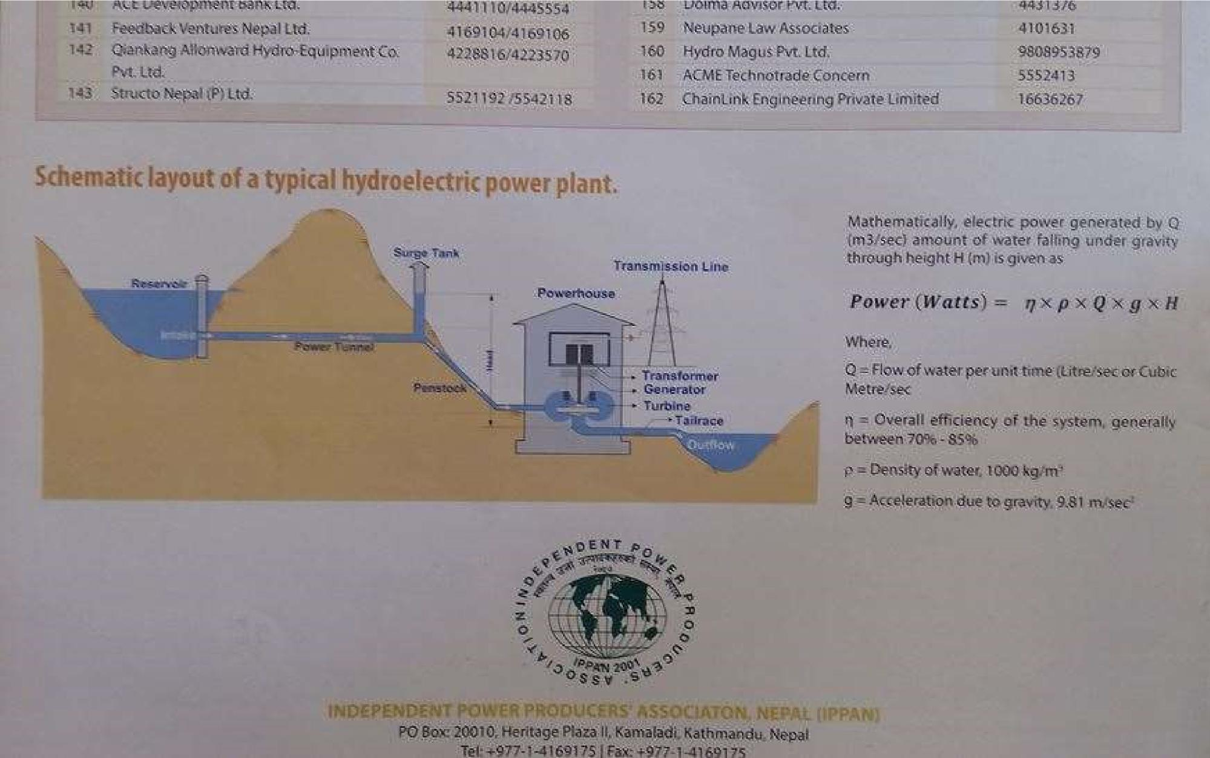
What information can you obtain from this photograph?

Slide 76
Self test
Briefly discuss the code of ethics of Nepal Engineering Council.
Explain the code of ethics applicable to engineering profession.
What do you understand by the code of conduct? Describe the code of conduct for engineers.
How do you judge the ethical standard of Engineers in Nepal? Describe the role of Nepal Engineering Council in maintaining ethical standard of Nepalese Engineers.
Differentiate between the NEA and NEC with suitable examples.
What are the meaningful roles of professional societies or associations? Why are they needed? Explain.

Slide 77
Explain roles of Engineering council and Nepal Engineers Association. In what regards, they are different?
What are the general job descriptions of engineers working in public sector?
Describe the basic duties of an engineer.
Professional Ethics in Engineering
Chapter 4: Legal Aspects and Regulatory Environment of Professional Engineering in Nepal
(8 hours)
Nepal Engineering Council Act
Labor Law
Contract Law

Slide 78
4.4 Cyber Law
Public Procurement Act
Intellectual Property Right
Company Registration Procedures
Relationship to foreign firms working in Nepal Electricity Act, 2049; Electricity Regulation, 2050
Legal Aspects and Regulatory Environment
Components of a Legal System
The legal system of a nation includes:
acts/laws, court decisions/precedents (ain, kanun, nirnaya/najir)
rules, regulations, bylaws, directives (niyam, biniyam, nirdeshika)
treaties, conventions, policies, (sandhi, prachalan, niti)
formation orders, ordinance, promulgations, (adesh, adhyadesh, ghoshana)

Slide 79
5. access to justice, freedom to choose legal advisor,
concepts of “innocent until proven guilty”, “equal under law” and 7.
implementation aspects, including consistency, of 1 to 6 above.
Nepalese Legal System
In Nepalese legal system, a person is practically “presumed guilty until proven innocent”. As soon as a person, or an officer, is charged of a crime, he/she is losses his/her official privileges, expected to resign from his/her post or automatically suspended till the case is “closed” by a court of law.
The Nepalese society normally presumes a person guilty as soon as s/he is charged of a crime. People have very low level of faith on the impartiality of justice/legal system. Many persons found guilty by a court, but with good connection, roam in government offices, while persons with low access to resources waits for years, even decades, for court verdict on cases he/she

Slide 80
files. नेपालको काननू दैवले जाननु ् !
सानालाई ऐन
ठू लालाई चैन !!
4.1 Nepal Engineering Council Act
No. of Chapters: 7, No. of
Regulate professional engineering practices •
Sections: 38
Chapter 1: Definitions:
d. Engineer: a person who holds at least a Bachelor's Degree in an engineering subject from an academic institution recognized by the council.
e. Engineering Profession: the profession to be practiced by the engineers who have acquired the technical knowledge and skill in the subjects
g. Registered Engineer: the engineer whose name has been registered in the Registration Book.

Slide 81
Chapter 2:
5: Constitution of the Council
Chapter 3:
15.Registration of Name: The Subject Committee scrutinizes application as per Section 14, and recommends to NEC Board, which decides on registration.
If decision is positive, the Registrar registers in the Registration Book.
4.1 Nepal Engineering Council Act
Chapter 3: Section 18. Name to be Removed from the registration:
mentally unsound,
property divided among the creditors for failing to pay debts,
charge of violating the code of conduct passed by 2/3rd majority,
convicted by a court in a criminal charge involving immoral act,

Slide 82
e) registered by fraud or error.
Chapter 4: Section 23. Inspection of Examination:
1) Before or after recognizing the certificate/degree, NEC can inspect examination system of the concerned academic institution. Section 24: Recognition to be withdrawn
Chapter 7: Section 30. Offences and Punishment and Penalties: 1) Practicing engineering without registration is an offence.
The offender of 30-1 is liable to a punishment of up to Rs. 3000 or an imprisonment of up to 3 months or both.
Offenders of the Act of other types can be fined up to Rs. 2000.

Slide 83
4.2 Labor Law, 2048 (1992)
No. of Chapters: 11, No. of Sections: 92 Chapter 1: Preliminary:
Enterprise: any factory, company, organisation, association, firm, … established for operating any industry, profession or service, with ten or more workers/employees
Worker: a person employed on the basis of
Labor Law 2073 (parliament approval August 11, 2017) (२७/४/२०७४) has
updated provisions.
remuneration, and worker at piece-rate, contract or agreement.
Minor: a person between 16 and 18 years of age
Chapter 2: Employment and job security
4.1: advertise to select worker and provide an appointment letter
4.2: One year (240 days in 12 months, including public and weekly holidays) probation, permanent appoint letter, inform to Labour Officer
4A.1: No non-Nepalese to be hired, unless skilled technicians not available even after advertising
5: Minor/female: 6 AM-6PM OK; females same as male with mutual consent
7: Contract: only in non-permanent type of work
10: Firing only by following procedure; 15: compulsory retirement at 55 age, may extend 5 years

Slide 84
Chapter 3: Working Hours
18: 8 hours/day; 48 hours/week, one day holiday/week; Max. 5 hr shift, including ½ hr tiffin break
19: Overtime at 1.5 times rate; no compulsory overtime; max. OT: 4 hrs/day. 20 hrs/week
Chapter 4: Remuneration
21: Agreement below minimum remuneration rate not allowed; 21A: Grade: ½ day wage
25.3: 3 times penalty for undue deduction in remuneration
25.4: Max. Rs. 1000 penalty if petition filed with malicious intent
4.2 Labor Law, 2048 (1992)
Chapter 5: Health and Safety:
27: Work area to be clean, supply of fresh air, light and proper temperature;
proper solid waste and noise management,
prevention of accumulation of dust, fume, vapour;
no congestion: minimum 15 m³/worker, maximum 4 m height
Adequate drinking and cleaning/washing water, fire extinguishing
Separate toilet for male and female; No-smoking zone
Compulsory health check once a year for hazardous works
28: protection of eyes; 29: personal protective devices against chemical hazard;

Slide 85
30: safety against fire; fire exit; fire-fighting devices; 31: Hazardous area to be fenced
Chapter 6: Welfare provisions
37: establishment of a welfare fund; 38: compensation for injury or death
39: Gratuity, provident fund, Medical expenses; 40: Leave
41: Provision of quarter; 42: If 50 or more female workers: provision of children’s room,
trained nurse, toys, time for female workers to feed suckling babies
If 50 or more workers: 43: relaxing room; 44: canteen
Chapter 7: Special provisions for special enterprise
46: Construction business
Chapter 8: Conduct and Punishment Chapter 10: Settlement of legal disputes
4.3 Contract Law, 2056 (2000)
No. of Chapters: 13, No. of Sections: 90 • Chapter 1:
(a) Contract: an agreement enforceable by law concluded between two or more parties for performing or not performing any work.

Slide 86
(b) Proposal: a proposal presented by one person to another with the intent of obtaining his/her consent to do or not to do any work.
(c) Consent: the consent given by the person to whom a proposal has been presented in the same meaning of that offer.
(d) Consideration: the promise made to do or not to do any work in return of doing or not doing of any work mentioned in the proposal.
Chapter 2: Contracting Parties, Proposal and Consent
3: Person competent to conclude contracts
16 years and sane; guardian may contract on behalf of incompetent
Chapter 3: Void and Voidable Contracts
13: Void Contract •
Chapter 5:
Chapter 6: Contract relating to Collateral and Deposit
Chapter 7: Contract relating to Sale of Goods
Chapter 8: Contract relating to Agency
Chapter 11: Execution of Contract and Obligation Arising out of the Contract
79. Contracts need not executed in the event of fundamental changes in the situation
Chapter 12: Breach of Contract and Remedies
14: Voidable Contract

Slide 87
4.3 Essentials of a valid contract
Offer and acceptance: An offer is a promise made by a party/person to another party/person with an intention of getting approval over his/her promise. A tender submitted by a contractor is considered as offer. The client, after due consideration and evaluation of the offer, provides acceptance of the offer.
Mutual intent to enter into contract: An agreement between two (or more) parties is not automatically a contract. A contract requires the parties intention to establish a legal relationship. The parties’ intention of entering into contract should be clearly reflected in the agreement.
Consideration: All the concerned parties of the contract should get something of value for fulfilling the terms and conditions of the contract.

Slide 88
Capacity to contract: A party (or person) entering into a contract should be of legal age and should be under his/her own control.
Lawful purpose: The objective of a contract must be lawful to be valid.
Free consent: The parties in a contract should have consented freely to enter into the contract. A contract signed under coercion, undue influence, fraud, misrepresentation etc. are invalid.
4.3 Void contracts (Section 13)
4.3.1 Void Contracts:
preventing anyone from engaging in any legal occupation, profession or trade.
restraining legal marriages.
preventing any one from enjoying public facilities.

Slide 89
d) seeking to prevent the legal rights of any person from being enforced by any government office or court.
concluded in matters, contrary to/prohibited by prevailing laws.
concluded for immoral purpose/against public morality or public interest.
which cannot be performed because the parties thereto do not exactly know about the matter in relation to which it has been concluded.
which is considered impossible to fulfill even at the time the contract is concluded.
which is vague (does not provide reasonable meaning thereof).
concluded by an incompetent person.
concluded with an unlawful consideration or objective.
4.3.2 Voidable Contracts (Section 14)
A contract concluded through:

Slide 90
coercion: threatens to withhold property, threatens defamation, takes actions against law
undue influence: influence exercised by a person upon another who is under his/her influence, like a ward/ subordinate/sick
fraud: knowingly leads the other party to believe untrue issue to be true, withholds or suppresses information
deceit: Submission of false particulars, falsifying document

Slide 91
The burden of proof rests on the claimant.
4.4 Cyber Law
Cyber law provides the legal basis related to the appropriate use of computer and information and communication technology by a person, organization and the government offices. • It regulates the computer and other electronic equipment based activities including business (ecommerce) and the government (e-
government). • Nepal has enacted the Electronic

Slide 92
Transaction Act 2063 and Electronic Transactions Rule, 2064.

Slide 93
Electronic Transaction Act, 2063 (2006)
To make legal provisions for authentication and regularization of the recognition, validity, integrity and reliability of generation, production, processing, storage,
communication and transmission system of electronic records.
For controlling the unauthorized access of electronic records (violation of the confidentiality) or of making alteration in such records through the illegal manner (violation of the integrity)
No. of Chapters: 12, No. of Sections: 80, 31 definitions
Section 2: Definitions:
2-a: "Asymmetric Crypto System“: a system that creates a secured key-pair consisting of a private key creating a digital signature and a public key to verify the digital signature.
2-j: “Key Pair“: a private key in an asymmetric crypto system and of pair of public key, interconnected in a mathematics form with the private key which has a code to verify digital signature by the public key to be created from the private key.

Slide 94
2-o: "Digital Signature“: a signature made in any electronic form to be included
in the transformation of electronic record by a person having a non- transformed initial electronic record and the public key of signatory by using a type of asymmetric crypto system that may clearly ascertain the following matters:
Whether or not transformation of electronic record was created by using a type of private key keeping a logical consistency with the public key of signatory; and
Whether or not the initial electronic record has been changed after the transformation of electronic record.
Chapter 2: Provisions Relating to Electronic Record and Digital Signature 3. Authenticity of Electronic Record: (1) Any subscriber may, subject to the provisions of this section, authenticate to any electronic record by his/her personal digital signature.
(2) While authenticating the electronic record pursuant to Subsection (1), an act of transforming such electronic record to other electronic record shall be effected by the use of asymmetric crypto system and hash function
4. Legal Recognition of Electronic Record

Slide 95
5. Legal Recognition of Digital Signature
Chapter 8: Provisions Relating to Network Service
Chapter 9: Offence Relating To Computer (Cyber Crime)
44. To Pirate, Destroy or Alter computer source code
Unauthorized Access in Computer Materials
Damage to any Computer and Information System
Publication of illegal materials in electronic form
Confidentiality to Divulge
To inform False statement
Submission or Display of False License or Certificates
Non-submission of Prescribed Statements or Documents
To commit computer fraud
Chapter 10: Provisions Relating to Information Technology Tribunal
Chapter 11: Provisions Relating to Information Technology Appellate Tribunal

Slide 96
4.5 Public Procurement Act, 2063
Systematic, fair, transparent and optimum use of public resources in procurement of goods and services by public entities
No. of Chapters: 10; No. of Sections: 76
2-a: “Procurement”: acquisition of any goods, consultancy services or other services or carrying out or causing to be carried out any construction works, by a public entity pursuant to this Act.
3: All procurement by any public entity should follow this act, else the procurement will be invalid.
Chapter 2: Responsibility for Procurement and Procurement Method
4: Description of Goods, Construction Works and Services to be Prepared
5: Cost Estimate to be Prepared
6: Procurement Plan to be Prepared
8: Procurement Method to be Selected
Chapter 3: Bid

Slide 97
12: Prequalification to be Determined
13: Bidding Documents to be Prepared 14:
Invitation to Bids
Chapter 4: Consultancy Services
30: Short List to be Prepared by Soliciting Expression of Interest Openly: 31 & 32: Soliciting and opening proposals
33: Evaluation of Technical Proposal
34 & 35: opening and evaluation of Financial Proposal
4.5 Public Procurement Act
Chapter 5: Other Provision Relating to Procurement
40 & 41: provisions related to sealed quotation and direct procurement Chapter 6: Provision Relating to Review of Procurement Proceedings or Decision
Chapter 7: Provision Relating to Procurement contract

Slide 98
54: Variation Order
55: Price Adjustment in Procurement Contract
56: Provision Concerning Extension of Contract Period
58: Mechanism for Dispute Settlement
60: Public Notice of Procurement Contract:
Chapter 8: Provision Relating to Conduct
61 & 62: Conduct of official and bidder
Chapter 9: Provision Relating to Monitoring of Procurement Activities
Chapter 10: Miscellaneous
66: Provision Concerning Procurement to be Made in Special Circumstances
67: Procurement Process under this Act not to be Applied
68: All records are to be in written form
69: Procurement Transaction May be Carried Out Through Electronic Communications Means
70: Legal Documents to be kept in Website

Slide 99
4.6 Intellectual property right (patent, design
and trademark, copyright)
The creations of human mind are considered as intellectual property. It covers
patents, designs, trademarks and copy right; the legal rights given to the creators of such properties are called intellectual property rights. The World Intellectual
Property Organization has listed the following as intellectual property.
Literary, artistic and scientific works
Performances of performing artists, phonograms, and broadcasts
Inventions in all fields of human endeavor
Scientific discoveries
Industrial designs
Trademarks, service marks, and commercial names and designations
Protection against unfair competition, and

Slide 100
All other rights resulting from intellectual activities in industrial, scientific, literary or artistic fields
The laws related to intellectual property rights in Nepal are:
(a) Patent, Design and Trademark Act 2022 (1965), amended in 1987 and (b) Copyright Act 2059 (2002).
Patent
Patent: As per the PDT Act 2022, the patent can be issued to any useful
invention based on new principle or formula, or any new way or method of construction, operation or transmission related to substance or a body of substance.
A patent should be duly registered, by submitting all the required documents, to have the patent right. Once registered, the right over the patent is protected for 7 years (plus two extensions, each of 7 years). The patent right is transferrable. The registered patent should not be used or copied without obtaining specific

Slide 101
written permission from the patent holder, until the patent duration expires,
within the jurisdiction of the patent provider. The law breaker can be fined up to Rs. 500000 and confiscation of the related items, and up to Rs. 250000 for committing an attempt of an offence.
A patent right cannot be granted if:
The patent is already registered in another person’s name
The patent was not invented by the applicant and the right to patent has also not been received from the inventor
The patent is likely to produce adverse effects on health, conduct and morality of the citizen or on national interest
The patent is against the existing law
Design
Design: The PDT Act 2022 has defined design as a feature, pattern or shape of a substance made by following any means.

Slide 102
The design should be registered to have design right. A registered design should be used by someone else only with specific written permission of the design right holder, until the design right duration expires (5 years plus two extensions, each of 5 years).
The breach of the design right constitutes a fine of up to Rs. 50000 and confiscation of the related items.
The design right cannot be issued if
the design was already registered by someone else, and
the design is likely to have adverse impact on the conduct or morality of a person or institution or on national interest. (c) The patent is against the existing law
Trademark

Slide 103
Trademark: The PDT Act 2022 has defined trademark as the use of any word, sign or picture or a combination of them by a firm, company or person to distinguish the product or services from those of others.
The trademark should be registered to have trademark right. A registered trademark, or its close imitation, should not be used by someone else. The right over a trademark can be protected forever subject to renewal (7 years in each renewal).
The trademark will not be registered if
the trademark has already been registered by someone else and
the registration will have adverse impact on the conduct or morality of a person or institution or on national interest.
The breach of the trademark right constitutes a fine of up to Rs. 100000 and confiscation of the related items.

Slide 104
Copyright
As per the Copy Right Act 2059, the copy right can be provided to the author of the works that are related to the following.
Book, pamphlet, article, and research paper
Drama, opera, dumb-show and similar works prepared for show
Musical works with or without words
Audiovisual works
Architectural design
Painting, sculpture, wood carving, lithography and architecture related other works
Photographic works
Works related to applied art
Excerpt, maps, plan, three dimensional works related to geography, topography, and scientific writing and articles

Slide 105
Computer program
The description or the explanations of the ideas, religion, news, concept, formula, law, court decisions, administrative decisions, folk songs, folk stories, proverbs & general statistics, even if they are included in any works, cannot be copy righted.
Specific registration is not required to have copy right.
There are two types of rights granted under the Copy Right Act: Economic and Moral. Moreover, the Act has granted rights to performers, producers of phonograms and to broadcasting institutions. The copy right is effective up to 50 years after the death of the author (or creator) of the copy righted materials. The copy righted materials can be used without permission in the following circumstances.
a) A portion of the work for personal use, as long as it does not hamper the economic right of the copy right holder.

Slide 106
For public cause or academic purpose, portion of a published materials may be
used with proper citation of the source, provided that the use does not directly benefit (economically) the user of the copy righted materials.
Libraries and archives can reproduce the works for general purpose.
Depending on the degree of infringement of the copy righted material, the penalty can range from Rs. 10,000 to Rs. 100000 or imprisonment up to six months or both for the first offense. The penalty doubles for the second offense. Besides, the offender shall be liable for compensation of the damages caused by his/her act.

Slide 107
SN | Particular | Copy Right | Patent | Design | Trademark
1 | Subject Matter/ Coverage | Rights related to work authorship/ literary work, artistic work: music, book, movies, painting, photos | Rights related to new inventions/theory/ principles, process, formula | Rights related to shape, pattern, color of commodities, product | Rights related to word, symbol, picture, figure or combination of all these to recognize goods or products
2 | Validity | Life time + 50 years 50 years from death of last surviving author For anonymous or pseudonym work: 50 years from first date of publication For applied art & photograph: 25 years from preparation of such work 50 years for posthumous publication | 7 years and two times renewable (21 years maximum) | 5 years and two times renewable (15 years maximum) | 7 years and indefinite period as long as timely renewed
3 | Infringement | Person other than owner comes up with same work, there is no infringement; can be copied and used without permission for academic, public welfare purpose, with source cited | Confers statutory monopoly that prevents anyone other than patent holder from making, using or selling | Confers statutory monopoly that prevents anyone other than design holder from making, using or selling | Confers statutory monopoly that prevents anyone other than trademark holder from making, using or selling
4 | Punishment on infringement | a) 10,000 to 100,000 or 6 months imprisonment, or both + confiscation b) 20,000 to 200,000 or one year imprisonment or both + confiscation | Rs. 250,000 to 500,000 + confiscation of product | Up to R. 50,000 + confiscation of product | Up to Rs. 100,000 + confiscation of product

Slide 108
Copy Right, Patent, Design and Trademark Comparison
5 | Start of protection | As soon as work is created (registration is optional) | From patent application registration date | From design application registration date | From trademark application registration date
6 | Requirement | Original | Novel/non-obvious, useful | New and different | New and different
7 | Application, registration and renew fee |  | Rs. 100; 1000; 300 | Rs. 100; 700; 200 | Rs. 100; 400; 150
8 | Governing Act | Copy Right Act 2059 | PDTA 2022 | PDTA 2022 | PDTA 2022

Slide 109
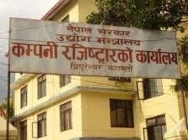
4.7 Company Registration Procedures
Application with following documents:
Filled application form, format as per Annex 1
Two copies of Prabandha Patra (Article of Association), and Niyamawali (Article of Memorandum) – Citizenship certificates of all the founder shareholders
In case of a public company, a copy of the agreement made among the founder members before the establishment of the company.
In case of a private company, a copy of the mutual agreement (if any). (Additional documents needed for foreigner registering a company.) Other considerations:
Max 101 founders in private company; minimum 7 founders in public company
Prabandha Patra and Niyamawali to be in Nepali
Each founder should sign on each page of Prabandha Patra and Niyamawali
Last page should have
full name, full signature, address, number of share of each founder,
full name, full signature, address of witness (one witness per founder)
full name, full signature, registration number of legal-professional or chartered accountant preparing the document, and date of document preparation

Slide 110
The OCR checks the documents and if found OK, notifies the applicant(s) to pay registration fee and collect certificate. If the Registered Capital is up to Rs. 5000, the charge can be paid at the OCR; else required fee to be deposited in NRB or other authorized banks in ‘RAJASWA’ account number1-1-05-
10. Two copies of the voucher to be submitted in the OCR’s A/C section, and then presented in the
registration section. After this, the company registration certificate (according to the index 5) and one copy of each (approved and signed by CRO Officer) of the ‘PRABHANDA PATRA’ and the
‘NIYAMAWALI’ presented by the founders are provided to the founders.
Only electronic registration, from Baisakh 2074, as per first amendment in 2074
http://www.ocr.gov.np/index.php/en/component/content/category/87-registration-process- information
•
4.8 Relationship to foreign firms working in Nepal
Hundreds of foreign firms are working in Nepal, directly or indirectly, as INGO, banks, industry, management consultants, engineers in consulting companies, software, outsourcing, …
Directly related acts: Foreign Investments and Technology Transfer Act,1992; Foreign
Exchange (Regulation) Act,1963; Immigration Act •
Policy
Foreign Investment Policy, 2015 aims to:
Foreign Investment and One Window

Slide 111
Attract foreign investment in energy efficient/non-polluting industries by granting additional facilities.
Establish SEZ or export promotion zones.
Promote Nepalese products in int’l market and protect intellectual property of such products.
Transfer of technology within a specified period of time.
Develop legal basis for technology transfer in industries where foreign investment is restricted.
Include supply of equipment under the ‘lease financing’ model, investment in bonds and debentures,
and investment through secondary market within the purview of foreign investment.
Technology transfer via – assignment, user’s licensing, sharing of technical know-how and franchising.
Institutional investors to invest through the secondary market (portfolio investment).
Form Foreign Investment Promotion Board to facilitate establishment of foreign investment based industries
Form SOP to simplify the process of foreign investment.
Limit customs tariff on machinery imported for foreign investment in kind to 4%.
Avoid double taxation with additional countries.
Rights to use immovable property in relation to HEP and infrastructure projects under the BOT model remain with the investor for the duration of the related BOT agreement.
Facilitate repatriation of amount remaining after liquidation of the company by the foreign investor.
Enable parties to determine the mode and venue of dispute resolution procedure in case of industries having over USD10 million as investment.

Slide 112
Foreign Investment under the law of Nepal
Foreign Investment: Investment made by a foreign investor in any industry in form of:
investment in equity,
reinvestment of earning derived from existing investment,
investment made in form of loan or loan facilities
transfer of technology,
lease finance,
opening a branch to carry out business.
Transfer of technology: transfer of technology under an agreement between foreign investor and an industry on the following matters:
use of any intellectual property rights of foreign origin,
acquiring any foreign technical consultancy and management,

Slide 113
c. acquiring foreign market service.
Foreign Investor:
individual, firm, company, foreign government or international agency
Rights, Guarantees and security of FDI
Fair and equitable treatment: No discriminatory treatment in all time,
Most-favoured nation treatment: transfer of funds, incorporation of a company, FDI approval etc.
National treatment: management, operation, protection, incentives etc.,
Guarantee against expropriation: no nationalization, (Industrial Enterprises Act,sec.21)
Nepal is a party to MIGA that protects political risks of FDI,

Slide 114
An industry established under FDI in Nepal is entitled to the incentives awarded to other industries, (FITTA,sec.2(a),
Guarantee for repatriation of FDI, (sec.5(2) FITTA)
Nepal is a party to BITs/BIPPAs concluded with some countries that protects FDI of the country concerned.
Resolution of investment disputes involving foreign forms
Investment disputes are contractual matters under Nepal law,
Disputes between a foreign investor and Nepali investor or concerned industry shall be settled by mutual consultation in the presence of DOI, (sec.7,FITTA)
If disputes could not be settled in that manner it shall be settled by arbitration under UNCITRAL Arbitration Rules, (sec.7(2) FITTA)

Slide 115
Disputes in regard to foreign investment exceeding NRs.5oo million, may be settled by any manner as the parties design,( Parties are free to decide the manner for dispute resolution), ( sec.7(4),FITTA)
Nepal is a party to New york Convention on Recognition and Enforcement of Foreign Arbitral Award(1958),
Arbitration Act,1999 is based on Model UNCITRAL Commercial Arbitration Act (1985)
Nepal is also a party to the International Centre for Settlement of Investment Disputes (ICSID) Convention (1969)
Potential Questions
How does Nepal Engineering Council regulate professional engineering practices in Nepal?
Discuss the process of registration of an engineer at NEC and conditions for cancellation of registration.
What are the employment and job security provisions for the workers, as per the Labor Act of Nepal?
What are the health and safety provisions for the workers, as per the Labor Act of Nepal?

Slide 116
What are the welfare provisions for the workers, as per the Labor Act of Nepal?
Discuss the essential elements of a valid contract.
What are the differences between a void and a voidable contract?
What are the basic objectives of the Electronic Transaction Act of Nepal?
What type of activities are considered to be an offence of the Electronic Transaction Act of Nepal?
What is the basic objective of the Public Procurement Act of Nepal?
What are the basic provisions in procurement of consultancy services by a public entity in Nepal?
Discuss the importance of the intellectual property right in the development of science and technology of a society.
Compare and contrast copy right, patent right, design right and trademark right, as per the laws of Nepal.
Discuss the process of a private company registration in Nepal, including the types of documents required.
What are the objectives of Foreign Investment Policy 2015 of Nepal?
What are the rights, guarantees and securities provided to FDI in Nepal?
What is the reason for the Nepalese government trying to attract foreign direct investment in Nepal?
Professional Ethics in Engineering

Slide 117
Contemporary and Emerging Issues in Engineering (6 hours)
5.0
5.1
5.2
5.3
5.4
5.5
5.6
Contemporary and Emerging Issues in Engineering
Globalization and cross cultural issues WTO perspectives
Public Private Partnership (PPP)
Development versus Environmental Degradation Addressing the Climate Change issues
Conflicts and Dispute management
Contemporary and Emerging Issues in Engineering
Efficiency in resource use (energy, human resource, bio-physical resource)
Safety (public, workers, users)
Environmentally and Socially justified development
Benefit Sharing and protection of private property right

Slide 118
Corporate Social Responsibility
Gender and cultural aspects
Child Right, Labor Right, Fair trade
Accountability in Engineering
Sustainability
Reduce, reuse, recycle: zero waste
Climate Change
Output and outcome; technical auditing, energy auditing
Transparency
E-governance, instant access to public information
Privacy of private information
Community involvement in project design
Automation of operation, monitoring and production process
Robotics and mechatronics
No trade barrier; WTO provisions
Genetic and Medical Engineering: balance between technology and moral values
Social Engineering
Development in transportation and ICT: Globalization

Slide 119
5.1 | Globalization and cross cultural issues
Rapid development in transportation and ICT: Globalization – transfer of goods and services and movement of human beings across the world at rapid rate, and impact of an incident in one corner of the globe felt across the globe
Need for understanding cross cultural values increase due to globalization
Knowing when to listen, when to ask for help, and when— finally—to speak
Developing effective relationship with people from cultures substantially different from ours.

Slide 120
Individualism versus collectivism.
Acceptance of power and authority.
Materialism versus concern for others.
Formality versus informality.
5.2 WTO Perspectives
World Trade Organization (WTO) is a worldwide organization for maintaining trade relation among different countries. WTO officially commenced on 1/1/1995. Nepal got WTO membership on 11/1/2061 B.S. WTO helps in setting trade disputes among countries and creates a healthy environment for global trading.
WTO deals with regulation of trade among member countries by providing a framework for negotiating and formalizing trade agreements and dispute

Slide 121
resolution. It determines the Terms of Trade, International Policies, and Rules for Global Trade.
WTO promotes world trade. It works for the implementation and operation of the various agreements made among different countries. It monitors and suggests improvements in the trade policies and rules of the member countries. It conducts programs for the livelihood upliftment and ensuring employment opportunities in member countries.
WTO facilitates in enhancement of productivity and income level of the ordinary people including food security in the countries.
5.2 WTO perspectives
Opportunities for WTO membership:
Government will become more rational in decision-making
Rent seeking activities will decrease
Problem of transit will be less

Slide 122
Provisions of technical support
Access to markets, duty-free-quota-free access among member countries Benefits of WTO in Nepal: (a) Market access opportunities, (b) Policy stability, (c) Attract foreign direct investment, (d) Gearing up domestic institutional capability, (e) Benefits of positive discrimination and (f) Establishment of trade and transit rights
WTO challenges for developing countries
Improving national policies
Amending some laws and developing new laws
Changing trade administration attitude
Human resource development and infrastructure development
Quality control of goods and services

Slide 123
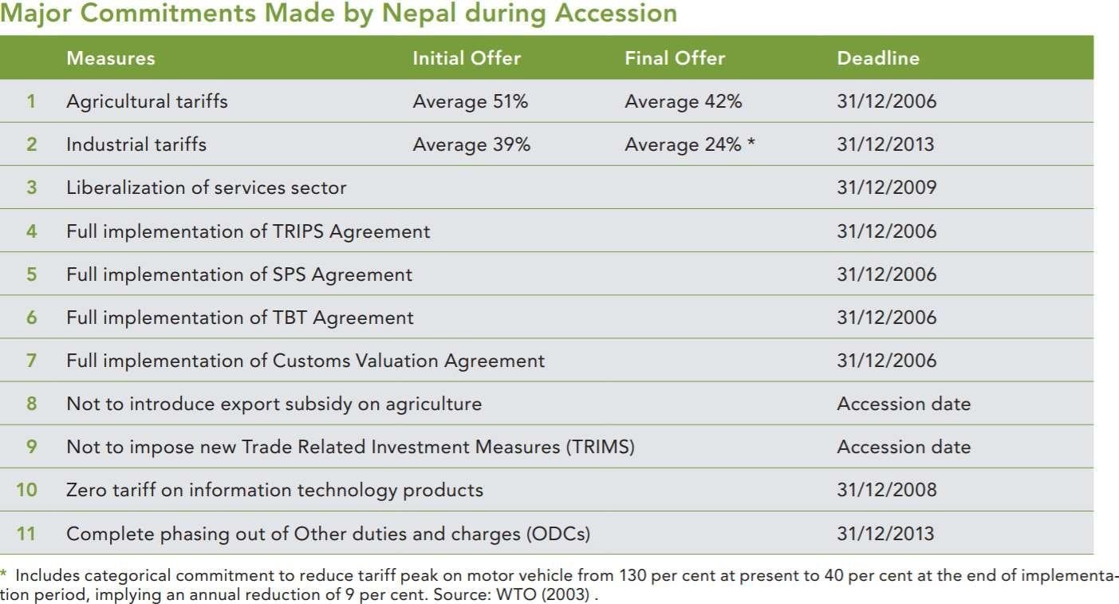
5.2 WTO perspectives

Slide 124
5.3 Public Private Partnership (PPP)
Definition: Funded and operated through a partnership of government and one or more private sector companies
Private party provides a public service or project
Assumption: substantial financial, technical and operational risk in the project
Enable public sector to harness expertise and experience
Fundamental principle of PPP: Public service provision can be linked with profit making business, which makes the operation of the public service provision sustainable and efficient. Public gets the service at lower price due to risk sharing, business gets profit, efficiency increases, government can invest tax in other areas rather than in inefficient projects.
Conditions for successful implementation of PPP:
Government’s willingness, confidence & institutional capacity to adopt PPP
Clear policy and clear legal provisions (acts, laws, rules, regulations)
Society ready to accept reasonable profit as a justified

Slide 125
5.4 | Development versus Environmental Degradation
Fair and transparent business environment
Technical, financial and management capacity of private parties
Status of PPP policies and programs in Nepal
– White paper on PPP, PPP Policy
Reasons for low level of PPP implementation in Nepal
Infrastructure construction and economic growth are not synonymous with development.
Development activities need to be sustainable.
Development which results in environmental degradation is unsustainable, and generates conflict.
Development without environmental degradation is possible.
Guidelines for project designs by considering environment prepared
Many government agencies now has environment section

Slide 126
Globalization, food security policy, energy and climate change and sustainable economic integration concepts are needed for development with environmental sustainability
Frontier thinking in sustainable development and human wellbeing needed
Ecological health and the positive relation between social and economic wellbeing is maintained.
The Environment Protection Act 2053 (Clause 7): nobody shall create pollution in such manner as to cause significant adverse impacts on the environment or likely to be hazardous to public life and People's Health Protection Rules 2054 while practicing engineering profession.

Slide 127
Two important examinations are to be carried out before initiating infrastructure projects: IEE and/or EIA
initial Environmental Examination (lEE)
A report on analytical study or evaluation to be prepared to ascertain as to whether, in implementing a proposal, the proposal does have significant adverse impacts on the environment or not, whether such impacts could be avoided or mitigated by any means or not
Environmental Impact assessment (EIA)
it is a report on detailed study and evaluation to be prepared to ascertain as to whether, in implementing a proposal does have significant adverse impact on the environment or not whether such

Slide 128
impact could be avoided or mitigated by any means or not for construction of national high ways and main feeder roads.
5.5 | Addressing the Climate Change issues
Climate Change (CC): sustained and gradual change in the nature of climate parameters, like temperature, rainfall, humidity, and wind speed
Science of CC: natural and anthropogenic; increase in green-house gas release
traps terrestrial radiation from escaping, resulting in rise in temperature, which affects global circulation of air, and changes timing and intensity of rainfall.
Effects of CC: rise in average and maximum air temperature, rise in night time temperature, increase in intensity of rainfall, decrease in number of rainfall days, increase in number of days with rainfall more than 100 mm, rise in devastating flood and landslide events, Glacial Lake Outburst Flood, increase in frequency and intensity of drought, increase in river bed rise and sedimentation
Impact of CC: agricultural fields washed, reduced agriculture production, damage to infrastructure due to flood and landslide, flash flood washing people,

Slide 129
GLOF damaging riverside settlements, villages under landslide, desertification
resulting in migration, increase in inundation and water borne diseases, tree line going uphill, insects appearing in higher elevation and spreading diseases
Role of Electronics and Electrical Engineers in CC mitigation: increase in energy efficiency – generation and use (LED bulb, motion detecting light bulbs, satellite monitoring of forest fire, litigation support against exhaust, remote monitoring of climate data using data loggers and relaying information, smart grid design, decrease in energy loss in transmission, environmentally sensitive developments, …

Slide 130
5.6 Conflicts and Dispute management
Conflict results when people have different (real or perceived) value or approach on particular issue(s).
Organizational Conflict: “Organizational Conflict is a state of discord caused by the actual or perceived opposition of needs, values and
interests between people working together.”
Three approaches to organizational conflict
Traditional approach (1930-40): Conflict is opposite of cooperation, and is inherently bad, negative and harmful for smooth functioning and progress of society, organization or a project. Conflict is equated to dysfunction and destructive, and must be avoided. It results from poor communication, disagreement, lack of trust, and low management skill.

Slide 131
Human Relations approach (1950-70): Conflict is inevitable and can be beneficial, if managed properly. It is not inherently bad.
Inter-actionist approach: Conflict makes an organization dynamic, and helps in finding best solution to problems. On- going manageable level of conflict should be encouraged as it prevents organization from being static. So conflict is good.
5.6.1 Levels and sources of conflict
Levels of Conflict
Intrapersonal conflict: conflict within self due to differences in goal, role, and personal values

Slide 132
Interpersonal conflict: between two or more persons; can be due to differences in goal, role, values, culture, communication gap
Intergroup conflict: between two or more groups of people
Inter-organizational conflict: between two or more organizations
International conflict: between two or more nations
5.6.2 Levels and sources of conflict
Sources of Conflict in an organization (or a project)

Slide 133
Personal differences/Personality clash: When the ideas, values, culture and
customs of a person (or persons) are incompatible with other persons of an organization.
Goal and role incompatibility: When the ideas, values, culture and customs of a person (or persons) are incompatible with the goal of an organization or assigned role of the person in the organization.
Organizational climate and change: When the work environment and rules of an organization are unpredictable, and when the rules or managers or owner of the organization suddenly changes.
Gender and other social differences: When the work environment and rules are designed to favor employees from a particular socio-cultural background or particular gender.
Availability and access to resources: When the availability of resources becomes too limited and/or unevenly distributed. When access to resources is uneven.
Communication gap: When there is communication gap between organization and its employees.

Slide 134
5.6.3 Conflict resolution methods: avoidance,
diffusion, containment, confrontation
Avoidance: avoid conflict, ignore conflict, “time will heal” approach; in this method the management will try to create a situation where conflict does not occur, for example by hiring workers from similar socio-cultural background. If conflict occurs, the management will wait for the situation to calm down, rather than taking any proactive situation.
Diffusion: distraction and defuse into multiple sectors; bring in “other” issues so that the main reason from the conflict becomes less important or one of the many issues; bring in other stakeholders..
Containment: conflict contained within certain people, and resolved through discussion and bargaining, in closed meetings, in the hope to resolving the conflict before it goes out of control or before it expands.

Slide 135
Confrontation: conflict brought in front of all concerned, conflict resolution through open dialogue, face-to-face meeting, open bargaining, and resorting to legal process, if needed.

Slide 136
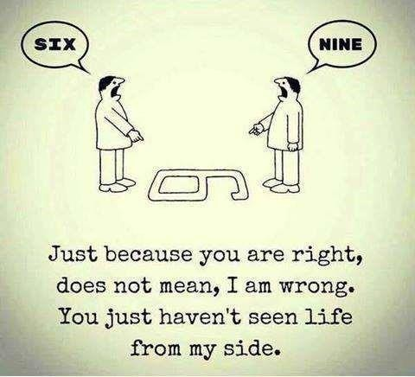


Slide 137



5.6.4 Dispute resolution methods: conciliation,
mediation, adjudication, arbitration, and litigation
Conciliation: Mutually agreed terms and conditions, “give and take” approach, without direct involvement of outsiders (mediator), even though the mediator assists in bringing the parties together.
Mediation: similar to conciliation, but with direct involvement of outsiders (mediator). The mediator facilitates, and intervenes, if needed, in conflict resolution process (as per Mediation Act 2068).

Slide 138
Arbitration: Resolution through certified licensed professional arbitrators, using the clauses of acts and regulations, after thoroughly investigating the issues of conflict. The arbitrators are normally selected, by mutual consent, from panel of experts.
Litigation: Resolution through court, as per prevailing laws, acts, rules, regulations, and legal precedents of a country.
5.6.5 Dispute resolution methods:
adjudication and arbitration as per PPA
Disputes are inevitable in construction projects and in engineering professional works. Dispute resolution procedures are normally mentioned in the conditions of contract. The Public Procurement Act 2063 (PPA 2063, Chapter 7, Section 58) and Public Procurement Rules 2064 (PPR 2064, Chapter 12) have provisions for dispute resolution.

Slide 139
If the parties in dispute cannot resolve the dispute through mutual consensus (amicable settlement), then, as per Section 129 of PPR 2064,
For works of value up to Rs. 100 million, disputes can be settled by sole
adjudicator (छनयण य ).
य कतण
For works of value above Rs. 100 million, disputes shall be settled by a Dispute Resolution Board (DRB) consisting of three members (one from private party,
one from public entity and one agreeable to both, Clause 130-2).
If the parties cannot settle dispute through adjudicator or DRB, then the dispute can be resolved through arbitration (मध्य्थकतणय ) or litigation (court), PPR, Section 135.
The adjudicator is a related technical expert with at least 5 years of experience. •
Remuneration of the adjudicator will be borne equally by the private party and public entity.
5.6.5a
Dispute resolution methods: adjudication and arbitration

Slide 140
Adjudication:
The adjudication is “a quick and relatively inexpensive way of resolving a dispute, whereby an impartial third party adjudicator decides the issues between the parties”.
The following are the characteristics of adjudication.
It is a mechanism of dispute resolution.
An independent third party, called adjudicator, awards the decision
Quicker and inexpensive mechanism of dispute resolution, compared to arbitration and litigation, normally taking less than 30 days after submission all relevant documents.
The Public Works Directive (PPD) and the Public

Slide 141
Procurement Act (PPA 2063, Section 58) have provisions for dispute resolution through adjudication.
5.6.5b
Dispute resolution methods: adjudication and arbitration
Arbitration
The arbitration is a formal mechanism of dispute resolution conducted outside a court, as per Arbitration Act 1999. The following are the advantages of arbitration over litigation.
It is a private alternative to formal court procedure: voluntary in nature
The arbitrators are technical experts; can result in creative solutions
Faster conclusion, within 120 days after submission of documents (Section 24)
Less expensive
No public hearing, so low publicity and less stress (which is normally preferred by the parties)

Slide 142
Less confrontational and formal, hence more convenient to the parties of dispute
Can appeal against decision in Appellate Court within 15 days (Section 21-2)
The PPA 2063 has recognized arbitration as a means of dispute resolution. Arbitration Act 1999 (Section 17) governs the arbitration procedure in Nepal. The Nepal Arbitration Council 1991 has been providing arbitration services in Nepal. However, in Nepal, most of the disputes go to court, or settled out of court through mutual consent, even after arbitration, by ignoring the arbitrators’ decisions.

Slide 143
5.6.6 Conflict versus Dispute
Conflict Dispute
Long term serious disagreement, non- Short term disagreement, over specific
specific issues issued, can be resolved
Non-negotiable issues Negotiable issues
Involves principle, values, ego, belief, Involves amount, money interest
Conflict does not turn into dispute, unless intervened.
Disputes, if unsettled, can convert into conflict
Each side is fundamentally opposed to the specific disagreement concerning a success of the other and will not compromise matter of fact, law or policy in which a their own values at the risk of allowing those claim or assertion of one party is met
they despise to achieve even the slightest victory (Burton, 1990)
with refusal, counter-claim or denial by another;

Slide 144
Self Test
Win-win scenario can be compromised.
Define conflict and explain the sources (causes) of conflict.
Discuss different levels of conflict.
Discuss different methods of conflict resolution.
Differentiate between conflict and dispute.
Discuss dispute resolution methods. Which method is better: adjudication or arbitration?
What are the major differences between mediation and adjudication?
Which method of conflict resolution is preferred by private parties, and why?

Slide 145
What are the major sources of dispute in an infrastructure development related construction project in (a) a remote area of Nepal, and (b) in urban areas?
Discuss the potential sources of conflict in (a) a high dam hydropower project, (b) fast tract highway, (c) broad gauge railway through mid-hills of Nepal, (d) international airport in Nijgadh, (e) multi-purpose water resources development project, (f) land pooling project for planned city development
Professional Ethics in Engineering
Case Studies Involving Professional Ethical Issues (4
Case Studies Involving Professional Ethical Issues
Copyrights and Patent Protection Personal Data Privacy
hours)
6.0
6.1
6.2

Slide 146
Industrialization and Environmental protection Risk/Benefit considerations in public transportation Engineers and the military
6.1 | Copyrights and Patent Protection
6.3
6.4
6.5
6.6
6.7
6.8
Science and technology for medicine Engineers in international development Arbitration
6.1.1 A fresh water resources engineering graduate (Engineer A) is approached by a Department of Groundwater (DoG ) senior engineer. The DoG engineer asks Engineer A to conduct a district-wide study of groundwater-surface water inter-link in Palpa, and provides a sample of a report to be produced. Engineer A finds that the sample report is based on a superficial study, with all the data taken from USA, and requests money to visit Palpa and collect field data. The DoG engineer refuses, saying that they got the project from low bid, asks Engineer A

Slide 147
to prepare the report based on assumed data and assures that Engineer A will not face problem since the contract to conduct the study was obtained by a consulting firm registered in DoG engineer’s spouse’s name, the DoG engineer himself is responsible to check the report quality, and Engineer A’s name will not be in the report.
List all the options for Engineer A.
Separate the options into moral, ethical, and legal categories.
Analyze each option based on ethics and risk to Engineer A.
6.1.1 List of options for Engineer A.
Follow the suggestions of the DoG engineer (use data from textbooks to prepare report)
Visit the site at Engineer A’s own expense, and prepare good
report based on field data.

Slide 148
Collect and study previous reports of the same area which provides related data and prepare report based on secondary information.
Refuse to be involved in the work and return the sample report to DoG Engineer.
Accept the assignment, secretly record further conversations with the DoG engineer and report the case to CIAA, with proof.
Publish an article in newspaper/magazine about the case, with the name of the DoG engineer.
Weak IPR laws bane for foreign investment; Published: March 14, 2017; by PUSHPA RAJ ACHARYA
Owing to trademark dispute with a local firm, Kansai Paint mulling over pulling out from Nepal
At a time when the government has been harping on foreign investment in a bid to advance Nepali economy, one of the reputed foreign joint ventures is mulling over retracting its investment from Nepal as a consequence of intellectual property rights (IPR) dispute with a local firm.
A Japanese foreign investment in Nepal, Kansai Paint, which entered Nepal in 2012 in joint venture with Nepal’s Shalimar Paints, has failed to obtain trademark from the Department of Industry (DoI). This is because capitalising on the weak intellectual property rights (IPR) laws in the country, a local investor had registered a firm under the name ‘Kansai Nerolac Paint Nepal Pvt Ltd’ at the Office of Company Registrar and had applied for trademark before the foreign joint venture.

Slide 149
6.1.2 | Breach of intellectual property rights & copyrights
The local firm — Kansai Nerolac Paint Nepal Pvt Ltd, which is run by Goyal Group — is in no way related to the Kansai Paint.
Since Nepal is a member of World Intellectual Property Organisation (WIPO), it is a pity that the country was unable to identify even a globally reputed brand like Kansai. The country may lose foreign investment worth Rs 350 million of the Kansai Paint, which entered the country through its Indian subsidiary Kansai Nerolac Paints India, as the DoI has scrapped the application of the foreign joint venture to obtain trademark of its own name.
As per Pradip Koirala, director general of DoI, the authorised agency under the Ministry of Industry to enforce Patent, Design and Trademark Act, the department had scrapped the application of the foreign venture as per the provision of law that provides favourable treatment on ‘first come, first served’ basis. He, however, admitted that the laws need to be amended to lure foreign investment citing foreign firms are sensitive in regard to intellectual property rights.
The globally renowned Kansai Paint had purchased 68 per cent stake of Nepal’s Shalimar Paints through its Indian subsidiary Kansai Nerolac Paints India and registered a company Kansai Paints Nepal Pvt Ltd. However, the foreign joint venture had faced a court case from the local company — Kansai Nerolac Paints Nepal Pvt Ltd. The Supreme Court, some four months back, had issued a verdict in favour of the local firm citing that it had registered the company prior to the foreign joint venture.
The local firm, which is producing paints under the brand of Nerolac and Kansai, again filed a case at the DoI and the DoI also scrapped the application of foreign joint venture and refused to issue the trademark it had sought. The foreign joint venture also faced unfavourable decision from the Patan High Court, where it had filed a case seeking protection of its trademark. As per the court’s decision, the company has to change the name of its product because the local firm has already captured the brand of reputed Kansai Nerolac Paint in the Nepali market.
Due to all these reasons, the foreign investors are now thinking about exiting from Nepal, according to sources. Nepali partners of the foreign joint venture have also backed this claim. “Kansai Paint, which came to Nepal through its Indian subsidiary after signing of bilateral investment promotion and protection agreement (BIPPA) with India during the premiership of former prime minister Baburam Bhattarai, has been left red- faced in Nepal,” said Ashok Vaidya, who is a Nepali partner of the foreign joint venture.
Kansai Paint, originally from Japan, has set up factories in 25 countries and is selling its product under its own name. Due to the country’s weak IPR laws, this case will establish a false precedence among potential foreign investors in Nepal, according to Vaidya. “The country will not only lose foreign investment, there are chances it will also lose its reputation across the globe if the foreign investors withdraw investment from Nepal.”

Slide 150
The foreign joint venture Kansai has been providing direct employment to 100 individuals and contributing revenue worth Rs 500 million to the government every year. Kailash Chandra Goyal, who has been operating the local firm under the name of ‘Kansai Nerolac Paint Nepal Pvt Ltd’ and producing paints under the brand name of Nerolac and Kansai refused to comment on the matter.

Slide 151
6.2 Personal Data Privacy
The US government asked the details of phone calls and emails of a seven persons it suspects as anti-nationals from a Europe based communication company, with a
branch in the USA. The company refused, citing its policy of protecting personal
privacy provision of its client, and requests to provide legal documents from US court for it to submit the data. The US government informed that the suspects are
planning to conduct a major crime and needs the information immediately. However, the company was adamant, also cited European and US laws prohibiting disclosure of personal data without a court subpoena. A major criminal incident occurred two weeks later and one person died; the US government arrested several persons including all the seven whose communication details it sought; and accused the communication company of collusion in the crime. The court found only one of the seven persons guilty of the crime.
A) Was it right for the US government to demand the personal data of all the persons it suspects of plotting a crime, without submitting subpoena?
B) Was it right for the company to refuse to cooperate with the demands of a legitimate government?

Slide 152
C) Do you agree that the company assisted the criminals by not providing the personal data to the US government?
D) Should the company assume responsibility for the crime?
E) Since one of the seven suspects was found to be involved in the crime, do you consider the demand of the US government to provide personal data of all the seven suspects justified?
F) Do you consider the European and US laws prohibiting disclosure of private data to a legitimate government without a court subpoena needs to be amended?
G) Do you consider the company liable for the breach of the right to life of the person who died in the incident?
6.3 Industrialization and Environmental protection
The Environment Protection Act compliance monitoring team is about to visit a major electronics industry, which was accused of dumping its lead based hazardous materials in a dug well which contaminated the groundwater and posed health hazard to the local residents. The manager of the industry asked the MIS officer to change the data in its system to show that it is complying with all the existing laws of hazardous waste dump. The MIS officer refused, saying that the data is available in many locations within the system, someone else may have downloaded the data which may eventually get in the hands of the

Slide 153
monitoring team, and that it is unethical to change the data. When the MIS officer was asked again to do the same act, he demanded the order in written form. The manager informed
that the potential penalty of the breach of the law can severely damage the industry’s financial condition and its image, and industry may be bankrupt. He promised that if the changes are made in the database and they are successful in averting penalty, the industry will install water treatment plant, provide the clean water to the local residents, and also
install proper hazardous waste management system thereafter; this will be in the benefit of
the industry, the local residents, and the industry’s employees.
Do you consider the demand of the manager moral and ethical?
Was it OK for the MIS Officer to ask for the written order?
Since changing the data seems to benefit of all the parties, should the MIS Officer comply to the demand?
If the MIS Officer did not comply, and the industry went bankrupt, what is the degree of responsibility of the MIS Officer for the joblessness of the employees?
If you are the MIS Officer, what would you do in this condition, and why?
6.4 Risk/Benefit considerations in public transportation
USA: In 2014, 32,675 people were killed in 29,989 crashes, an average of 96 per day. The number of deaths, and deaths relative to the total population,

Slide 154
has declined over the last two decades. From 1979 to 2005, the number of deaths per year decreased 14.97% while the number of deaths per capita
decreased by 35.46%. The 32,479 traffic fatalities in 2011 were the lowest in
62 years (1949).
Nepal: According to Nepal Police records, 1,356 people died in road accidents in the fiscal 2008-09, 1,734 in 2009-10, 1,689 in 2010-11, 1,837 in 2011-12, 1,816 in 2012-13, 1,786 in 2013-14 and 2004 in 2014-15. At least 1,305 road fatalities were reported in the first 10 months of the current fiscal. On an average, 1,800 persons die in road accidents in Nepal every year. Police say road accidents are on the rise due to increased vehicular traffic. A fairly large number of accidents go unreported, because the parties involved settle the matter themselves. (August 4, 2017, THT) Based on the information given above answer the questions.
A) What is the trend of fatal road accidents in Nepal versus USA?
B) Considering that the population of the USA is 330 Million, and vehicle ownership is 1 vehicle per 1.3 person, compare the numbers given above in terms of fatalities per million population and fatalities per number of

Slide 155
vehicles; the total number of vehicles registered in Nepal, including motorbikes, is about 2 million.
C) As an electronics engineer, what role can you play in reducing risk of fatal road accidents in Nepal?
6.4 Risk/Benefit considerations in public transportation
The Public Transportation Entrepreneur Association (PTEA) demanded 15% rate hike in bus fare when the diesel price went up by 10%. PTEA claimed that the risk and benefit associated with operation of public buses is linked with diesel price; as fuel price rise risk increase (higher investment for lower return) and benefit decrease (lower seat occupancy). So to compensate for rise in risk and drop in benefit, the bus fare needs to be raised by higher percentage.
The Government of Nepal (GoN) did not agree with the PTEA logic. GoN said that the bus fare is based on fuel, vehicle maintenance, tyre wear and tear, lubricants and oils, driver and helper’s wages, bank loan, and profit on investment. Since the price of only one of the

Slide 156
parameters has increased, it is unfair and unethical to increase bus fare by more than 2%.
GoN refused the PTEA demand saying that the diesel price is not linearly related with diesel price. The PTEA threatened to call a strike if their demands are unmet within 48 hours. Eventually a technical committee was formed to settle the dispute, and appointed you as the decision maker. Prepare your report which addresses all the issues raised by PTEA and GoN, electronic monitoring of seat occupancy, and a design to automatically revise bus fare in similar situations in the future so that the risk and benefit in operation of public transport is transparent.
6.5 Engineers and the military

Slide 157
The Nepalese Army (NA) has already established a medical college and planning to run an engineering college. The NA is engaged in disaster Risk Management and construction of fast track highway and also planning to invest in hydropower sector in Nepal.
(a) if you are an engineer working for the NA, what suggestion would you give to the decision makers for further expansion of the NA in other sectors where engineering services are needed?
(b) if you are an engineer working in a private sector in hydropower development and/or highway sector,

Slide 158
what is your suggestion/opinion on the gradual expansion of the NA in the sectors traditionally handled by the private sector engineering firms?
6.6 Science and technology for medicine
An insurance company asked for the medical records of one of its clients, claiming that the patient has unreported a pre- existing condition, and hence ineligible for reimbursement of expenses. The hospital administrator asked you, the IT Officer, to provide the records. You asked the part-time doctor who checked the patient; the doctor refused to allow you to submit the report, citing patient confidentiality provision. The administrator then asked you to make a copy of the report and submit to him or reveal him the password of the hospital MIS system. The administrator also threatens

Slide 159
to take disciplinary action against you if you did not act accordingly.
A) What are your options in this situation? Which options are ethical and which ones are unethical?
B) Is there any way to fulfil the administrator’s demand
without compromising patient confidentiality?
C) As a professional engineer, what should you do in this situation?
6.6 Science and technology for medicine
Many governments have banned stem cell research or erected obstructions in SC research.
Stem cell research thus raised difficult questions:
Does life begin at fertilization, in the womb, or at birth?

Slide 160
Is a human embryo equivalent to a human child? Does a human embryo have any rights?
Might the destruction of a single embryo be justified if it provides a cure for a countless number of patients?
Since embryonic stem (ES) cells can grow indefinitely in a dish and can, in theory, still grow into a human being, is the embryo really destroyed? http://learn.genetics.utah.edu/content/stemcells/scissues/
What are the roles of an electronics engineer in addressing these questions?

Slide 161

6.7 Engineers in international development
Engineers without Border Policy Intervention
Sustainable, balanced, justified development
Site specific research for reliable design: bio-physical aspects Access to the fruit the development: affordability

Slide 162
Energy – Water – Food Nexus
Culture and Disaster Sensitive Development
Conflict free development: local livelihood, benefit sharing
6.7 Engineers in international development
You are assigned to design an integrated circuit / hydropower dam for a project in a country which is considered hostile to your country.
A) Should you accept the assignment and do your best professional work for the project?

Slide 163
B) Should you accept the assignment and secretly and deliberately introduce bug in the
program, or introduce weak section so that the project will eventually fail and result in a disaster?

Slide 164

6.8 Arbitration
The project you are involved in from the contractor’s side is in dispute with the consultant and client. The client refused payment even after completion of work citing 30-days delay in work completion. The delay was due to initial 5-day strike by the contractor’s workers, immediately followed by a 6-day national strike by a political party. The contractor claimed that it could have completed the work if there was no national strike, which resulted in the workers returning home and also resulted in unavailability of construction materials in time, and hence not responsible for the

Slide 165
delay; the client cited workers’ strike as the main cause
of delay.
Which method of dispute resolution would you prefer –
arbitration or litigation?
Prepare your logic for full payment claim.
Arbitration Committee formed in Melamchi Dispute:
CMC vs. Megatech

Slide 166
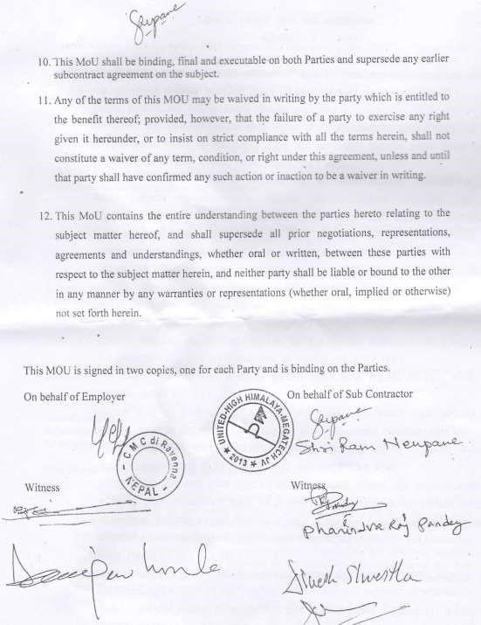
भेरम्ची आमोजनाको भरू ठे के दाय य सहामक ठे के दायफीच बुक्तानी
बफफादराई सल्टाउन ऩ हरूको अनुयोधभा खानेऩानी भन्स्टत्रारमका सहसचचि अचनरबद्र खनारको
संमोजकत्िभा भरू ठे के दाय य सहामक ठे के दायहरूका तपफिाट १/१ जना
प्रचतचनचध यहने गयी ३ सद्मीम
भध्म्थकता फसचभचत गठनगन ाे आऩसी सहभचत बए फभोजजभ हहजो एक सचभचत गठन गरयएको ि । मो कचभटीरे ऩ हरूफीच आऩसी
सहभचतका आधायभा

Slide 167
बुक्तानी बफफाद सल्टाउने चसपारयस गन ाे य सोही िभोजजभ सभ्मा मथाचचघ्र सभाधान हुने अऩेा ाा सफै सयोकायिाराको यहेको ि ।
Facebook Post of Mr. Bhim Upadhyay, Secretary, Ministry of Water Supply and
Sanitation, August 11, 2017
Some basic guidelines in analyzing case studies
Read the question carefully, paying attention to adjectives.
Analyze the case from ethical, moral, social, legal and professional angles, and assign role/responsibilities of each party involved in the case.
Base your analysis, wherever appropriate, on professional code of conduct of NEC, NEA, FCAN, SCAEF, IEEE, CAN, or any other professional organization. Specifically mention code, if you can.

Slide 168
Many cases involve conflict of interest (COI); if the case you are dealing with is related to COI, specifically mention it.
If specific laws are applicable, perform legal analysis and mention the law, and specific sections/clause(s).
Make your recommendations impartially, thinking of you as an impartial judge, considering existing social, technical, legal and professional codal provisions.
Sample Case studies (i): A client came to a designer and asked to design a multistoried building. The soil type of the proposed site was found not suitable for that type of structure. The designer hesitated to design the building. The client said that he actually was not going to build that structure. He wanted to collect money from outside sources showing that designed as a proposal for his venture and wanted to utilize that money in other business. Explain the roles of the client and the designer in the perspective of professional ethics.
Your answer should address the following issues.
Role of Client and Designer (a) Is the intention of the client legal? (b) Is the intention of the client moral?
(c) Is the intention of the client ethical?

Slide 169
Morally, ethically, and legally, what should the designer do after knowing the real intention of the client?
Should the client be penalized for telling the “real intention” to the designer?
Should the designer refuse to design? If yes, why? If no, why? Should the designer refuse to design and just keep quite?
Should the designer just submit a design and keep quite because what the client does with the design is
none of the designer’s business?
Should the designer design with piles (or other suitable foundation design) to make the structure suitable for the type of soil?
Since the client is not going to build the structure anyway which does not increase hazard from the building to anyone, what is wrong in just providing a design, as a hypothetical case?
Should the designer refuse to design and inform the government officials about the client’s intention? Should the designer refuse to design and inform the media, or write an article in the newspaper, about the intention of the client?
As long as the design is structurally sound, is the designer responsible (morally, ethically, legally) for what the client does with the design?
Sample Case studies (ii) A recently built simply supported RCC roof slab of a single storied poultry farm in Chitwan, collapsed and killed all the chickens in the farm. The farm owner blamed the labor contractor for the defective work. The contractor denied and accused the client for providing low quality and inadequate amount of steel bars for the roof slab. The farm owner then asked for compensation from the steel bar supplier (for inferior quality bars) and the consultant (for improper supervision during construction). The

Slide 170
bar supplier defended herself by saying that the farm owner bought the cheapest bar from her which has no guarantee. The consultant reported that the cause of the roof collapse is the use of very dirty water in mixing the concrete, which was provided by the farm owner and used by the contractor despite objections from the consultant’s site supervisor.
Analyze the situation carefully and decide which party (client, contractor, and consultant) is more responsible or less responsible for the roof collapse. Explain your decision with reference to the Code of Conduct of NEC and FCAN.
Things to notice before assigning degree of responsibility:
Client: (a) Did only labor contract with the contractor, supplied materials on her own, (b) Supplied low quality steel bars (thinks all steel bars are same), (c) Supplied inadequate quantity of steel bars (shows no faith in design details), (d) Supplied dirty water for concrete mixing, despite objections from consultant (thinks water quality unrelated to concrete quality)
Contractor: (a) Worked with low quality steel bars, knowingly. Thought that contractor is not responsible for material quality since it is only labor contract. (b) Tied inadequate numbers of steel bars (increased steel bar spacing), knowingly. Thought that contractor is not responsible for material quantity since it is only labor contract. (c) Used very dirty water to mix concrete, knowingly, despite objections from consultant.
Consultant: (a) Did not or could not stop client from supplying low quality steel bars, (b) Did not stop contractor from tying inadequate number of steel bars, (c) Did not or could not stop client and contractor

Slide 171
from use of very dirty water to mix concrete, (d) Reported the problems only after roof collapse and client’s
compensation claim

